Slide 1

BACKEND · SHIFTS, ROSTERS AND TRAINING
Under the Hood
How the API schedules shifts, builds weekly rosters, tracks attendance and controls trainer access
ASP.NET Core 8 · EF Core 8 · PostgreSQL

Slide 2




OVERVIEW
What this part of the API does
01
02
03
04
Shifts and capacity
Creating shifts and working out how many volunteers each one needs.
Rosters
Generating a week's roster, and the rules every placement must pass.
Notifications
Publishing rosters, push notifications and evening reminders.
Attendance and training
Hours worked, trainer PIN access and the sign-off order.
Notes:
- Shifts, rosters, notifications, attendance and training

Slide 3







ARCHITECTURE
Rules live in services that query the database directly
Controller
ShiftsController: routes and roles
Service
ShiftService: the business rules
AppDbContext
EF Core turns LINQ into SQL
Database
PostgreSQL
EF Core 8 + Npgsql
LINQ queries with Include and projections.
Background workers
Scheduled reminders with BackgroundService.
Why no repository layer?
The rules join shifts, rosters, skills and availability, so the services query AppDbContext directly with LINQ.
Expo push
A typed HttpClient sends phone notifications.
"TrainerAccess" policy
A JWT policy that guards trainer endpoints.
.SelectMany(s => s.Skills)
Notes:
- Controller -> service -> AppDbContext -> PostgreSQL
- No repositories: cross-table rules in LINQ
- Workers, Expo push, TrainerAccess policy

Slide 4
SHIFTS API
Everyone can read shifts, only admins can change them
GET
/api/Shifts
Any user
CreateShiftDto.cs DTOs/Shifts
11
12
13
24
25
26
27
28
[Required]
[MaxLength(100)]
public string ShiftName {get; set ;} = null!;
…
[Range(0, int.MaxValue)]
public int? BirdCount {get; set;}
[Range(1, int.MaxValue)]
public int? Capacity { get; set; }
GET
/api/Shifts/week?weekStartDate=
Any user
GET
/api/Shifts/locations
Any user
POST
/api/Shifts
Admin
PUT
/api/Shifts/{id}
Admin
Checked before the service runs. A missing name or a capacity below 1 returns a 400 with the reason.
DELETE
/api/Shifts/{id}
Admin
Deleting is refused once a shift is on a roster.
Notes:
- Reads for any signed-in user, writes Admin-only
- DTO validation: Required, MaxLength, Range

Slide 5
SHIFT CAPACITY
How many volunteers a shift needs
SUPPORTING AREAS
PEN ROUTINES
QUARANTINE
Manual
1 per 30
1
The admin enters the capacity.
One volunteer for every 30 birds, rounded up.
Always exactly one volunteer, to limit contact.
e.g. Laundry: 2
75 birds → 3 volunteers
Any bird count → 1
capacity = (int)Math.Ceiling(birdCount.Value / 30.0);
The web app's form currently shows 1 per 25; the API's 30 is what gets saved.
Notes:
- Supporting areas: manual
- Pen routines: ceil(birds / 30)
- Quarantine: always 1
- Note the 25 vs 30 mismatch with the web form

Slide 6
VACANCIES
Open spots, worked out in one query
Vacancies = Capacity − active bookings (cancelled ones don't count)
VacancyService.cs GetAllVacanciesAsync
22
23
24
25
26
27
28
36
37
38
39
40
return await _context.Shifts
.Where(s =>
s.ShiftDate >= today &&
s.Capacity > s.RosterAssignments.Count(ra => ra.Status != RosterAssignmentStatus.Vacant))
.OrderBy(s => s.ShiftDate)
.ThenBy(s => s.TimeSlot)
.Select(s => new VacancyDto
…
AssignedVolunteers = s.RosterAssignments.Count(ra => ra.Status != RosterAssignmentStatus.Vacant),
VacanciesAvailable = s.Capacity - s.RosterAssignments.Count(ra => ra.Status != RosterAssignmentStatus.Vacant),
RequiredSkillIds = s.Skills.Select(skill => skill.SkillId).ToList()
})
.ToListAsync();
1
Future shifts with room
Past shifts and full ones are filtered out.
1
2
3
2
Straight into a DTO
EF Core builds one SQL query, no loops.
3
Done in the database
Capacity minus active bookings.
Notes:
- Formula: capacity minus active bookings
- One query with a projection
- Only future shifts with room

Slide 7



ROSTERS
Generating a week's roster
1
2
3
4
5
Monday start
Any other day is rejected.
Draft roster
An existing week is returned, not duplicated.
Each shift
In date, then time-slot order.
Try volunteers
Every rule checked for each one.
Stop when full
Move on once capacity is reached.
RosterService.cs GenerateRosterAsync
One set of rules
Generation places volunteers through AssignVolunteerAsync, the same method an admin uses by hand, so automatic and manual rosters follow identical rules.
224
225
226
227
228
229
230
231
232
233
foreach (var shift in shiftsForWeek)
{
var assignedCount = 0;
foreach (var volunteer in volunteers)
{
if (assignedCount >= shift.Capacity)
{
break;
}
5
await AssignVolunteerAsync(
Notes:
- Monday, draft, each shift, try volunteers, stop when full
- Same rules as manual assignment

Slide 8




ROSTER RULES
Nine checks before anyone is placed on a shift
Not already on it
No double placement on one shift.
No overlapping shift
Nothing else at the same time that day.
Available that day
Full-day availability covers either half.
Skills signed off
Every skill the shift requires.
5 days a week
At most, counting working days.
4 days in a row
At most, across the days either side.
40 hours a week
At most, including the new shift.
Room on the shift
Never over its capacity.
Quarantine
1 volunteer per shift, 3 days in a row at most.
Notes:
- Nine checks in AssignVolunteerAsync
- Duplicates, overlap, availability, skills, limits, capacity, quarantine

Slide 9
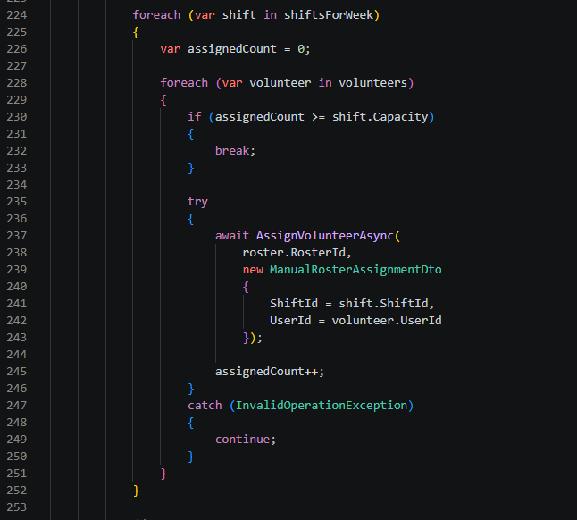
ROSTER RULES
Only volunteers that meet all business are placed
Required by the volunteer assignment.
RosterService.cs GenerateRosterAsync
Roster Generation meets business rules
When a roster is being generated it calls the AssignVolunteerAsync method which runs all the checks to determine whether a volunteer can be placed in that shift slot. A volunteer who does not meet all the criteria will then be skipped over and the checks will run for the next volunteer until the shift capacity is filled with eligible volunteers.
Notes:
- Required skills minus signed-off skills = missing
- Anything missing blocks the placement

Slide 10
ROSTER RULES
Only trained volunteers are placed
Required by the shift
Signed off for the volunteer
RosterService.cs AssignVolunteerAsync
379
380
381
382
383
396
397
398
399
400
401
402
403
404
var requiredSkillIds = await _context.Shifts
.Where(s => s.ShiftId == dto.ShiftId)
.SelectMany(s => s.Skills)
.Select(s => s.SkillId)
.ToListAsync();
…
var missingSkillIds = requiredSkillIds
.Except(signedOffSkillIds)
.ToList();
if (missingSkillIds.Count > 0)
{
throw new InvalidOperationException(
"The volunteer does not have all required skills for this shift."
);
Missing
Covered
Other skills
Anything in “Missing”? The volunteer isn't placed.
Notes:
- Required skills minus signed-off skills = missing
- Anything missing blocks the placement

Slide 11
ROSTER RULES
Protecting volunteers from overwork
5
4
40
1
3
days
a week
days
in a row
hours
a week
volunteer
per quarantine shift
days
of quarantine in a row
Five days
if (isNewWorkingDay && assignedDatesThisWeek.Count >= 5)
Forty hours
if (scheduledHoursThisWeek + newShiftHours > 40m)
Quarantine
if (quarantineVolunteerCount >= 1)
Notes:
- 5 days, 4 in a row, 40 hours
- Quarantine: 1 volunteer, 3 days in a row

Slide 12


PUBLISHING
Publishing a roster tells every volunteer
In-app notification
Saved for each assigned volunteer.
Admin publishes
PATCH /api/Rosters/{id}/publish
Draft → Published
Only once. Publishing again is refused.
Push to their phone
Sent through Expo's push API.
roster.Status = RosterStatus.Published;
await _expoPushNotificationService.SendPushNotificationAsync(
Notes:
- Publish once
- In-app notification + Expo push for each volunteer

Slide 13
REMINDERS
Background workers that run on a schedule
EVERY DAY
Remind tomorrow's volunteers about their shifts
00:00
06:00
12:00
18:00
24:00
EVERY WEEK
Mon
Tue
Wed
Thu
Fri
Sat 18:00
Sun
Saturday: remind every volunteer to update their availability for the coming week.
Wait until 18:00
Fresh scope each run
var nextRun = now.Date.AddHours(18);
using var scope = _scopeFactory.CreateScope();
The worker lives for the app's lifetime, but needs a new database scope for every run.
Notes:
- Daily 18:00 shift reminders
- Saturday availability reminders
- New DI scope per run

Slide 14
ATTENDANCE
Hours come from the shift, not from typing
08
09
10
11
12
13
14
15
16
17
Morning
08:00-13:00
5 h
Afternoon
14:00-17:00
3 h
Full day
08:00-17:00
9 h
Attended or missed
Attended gets the slot's hours, missed gets 0.
One row per assignment
Marking again updates the row instead of adding another.
Admins only
Only admins can mark attendance; volunteers see their own hours.
decimal hoursWorked = dto.Attended ? GetShiftHours(rosterAssignment.Shift.TimeSlot) : 0;
Notes:
- 5 / 3 / 9 hours from the slot
- Upsert one row per assignment
- Admin-only marking

Slide 15

TRAINER ACCESS AND TRAINING
A shared tablet, and skills signed off in order
Enter the shared PIN
Checked against configuration, never stored in code.
SUPPORTING AREAS
Every one signed off first
Get a 4-hour token
Role Trainer, with access_type=trainer.
unlocks
PEN ROUTINES
SEASONAL
"TrainerAccess" policy
Only trainer tokens reach trainer endpoints.
Trying earlier gets a clear refusal:
"All Supporting Areas must be completed before a Pen Routine can be signed off."
Sign off a skill
Recorded against the trainer.
And a skill can't be signed off twice.
Notes:
- Shared PIN -> 4-hour trainer token -> TrainerAccess policy
- Supporting Areas unlock Pen Routines and Seasonal

Slide 16




WHAT'S NEXT
Rules the roster can trust
Fairer rosters
Rotate who gets tried first, instead of always the same volunteers
South African time
Run the 18:00 reminders in local time, not server UTC
One bird ratio
Agree on 25 or 30 across the web form and the API
Thank you

